Slide 1

Cayman Islands
Network Report
Presented by Lee Madison
Deputy Director of Operations and Communications

Slide 2
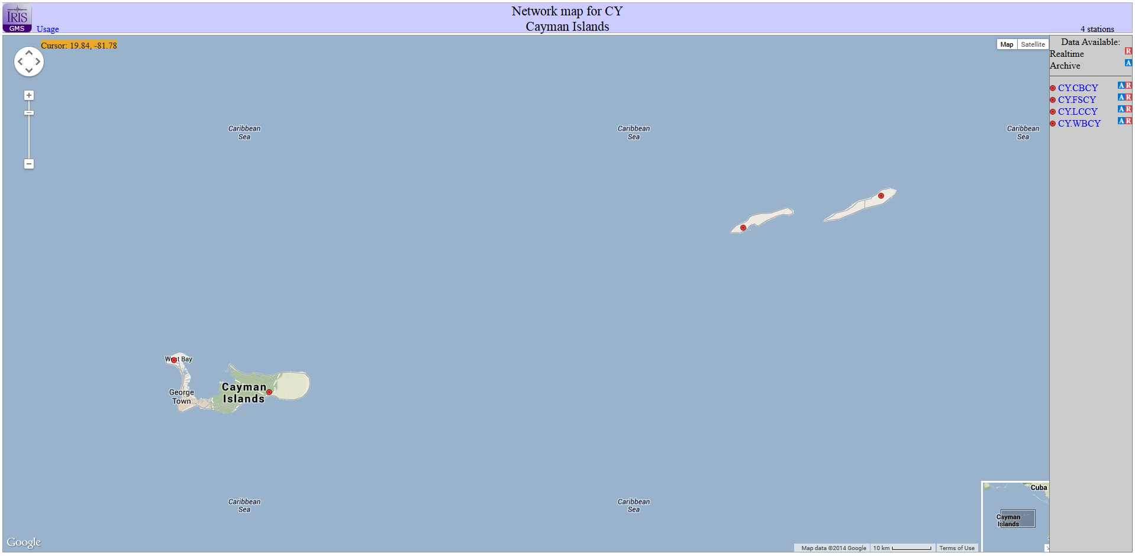
Seismic Stations

Slide 3

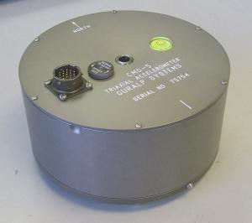
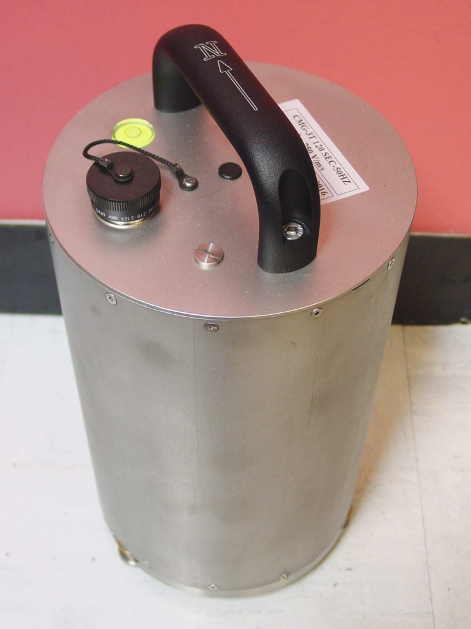
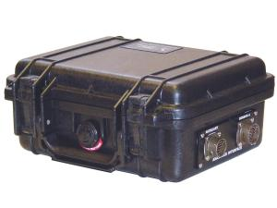
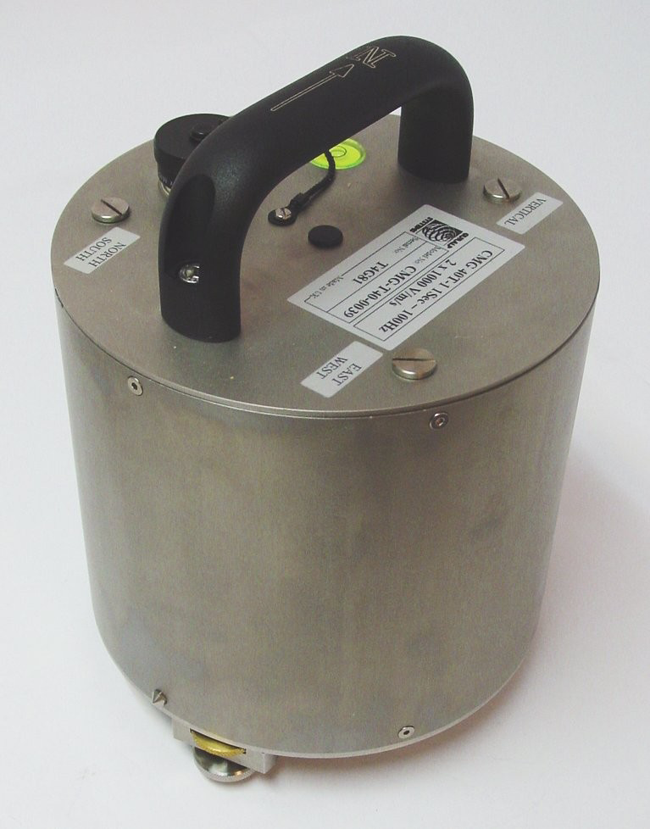
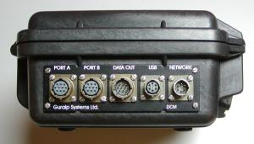
Equipment
CMG-5T
CMG-40T
CMG-3T (CYB)
CMG-M24MK3
CMG- DCM

Slide 4
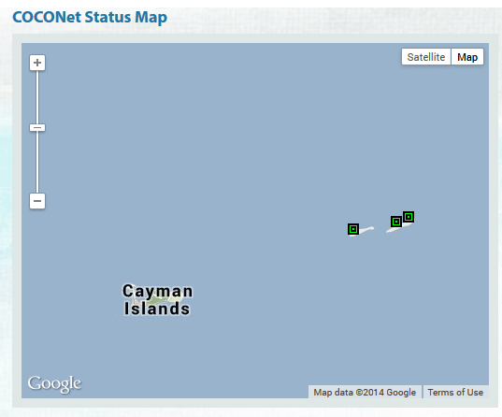

COCONet Stations
Closing soon

Slide 5
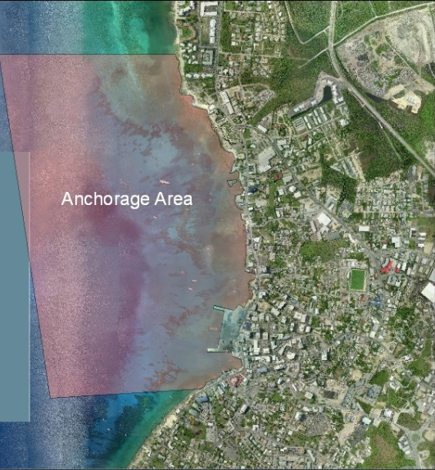
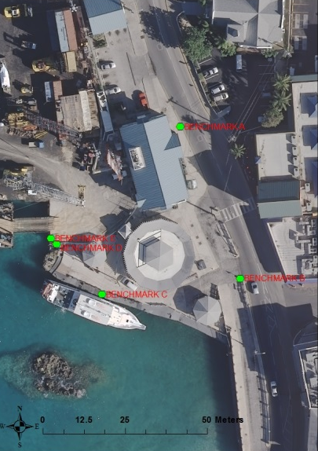
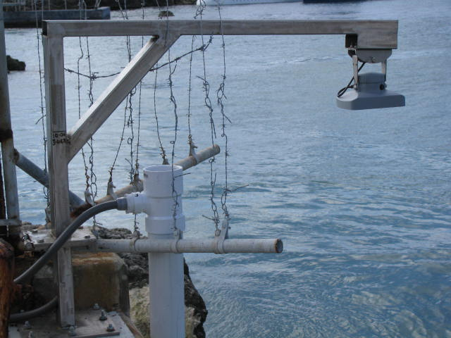
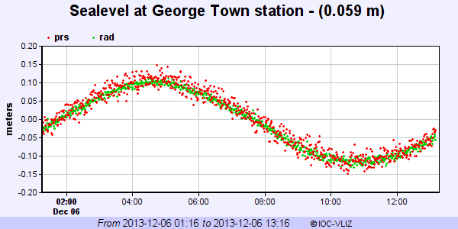
Tsunami Tidal Gauge

Slide 6
Issues
Little Cayman modem changed. No one informed.
West Bay communications problems.
Site need to be relocated
Earthworm needs updating
Main server to relocated to new building later this year

Slide 7
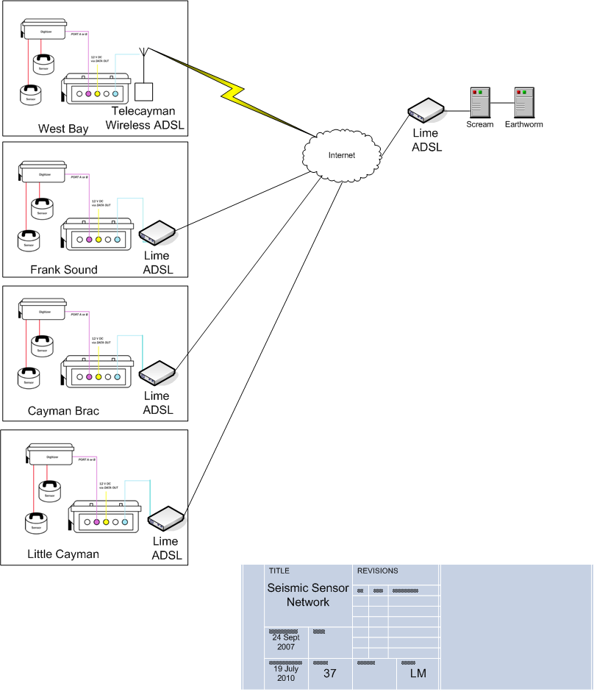

Slide 8
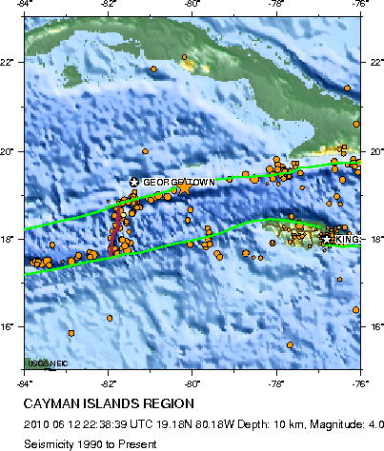
ACTIVITY
Activity

Slide 9
QUESTIONS?

